Slide 1


Sap ABAP on Hana &
s/4hana trainings
Anubhav Oberoy

Slide 2

INTRODUCTION

Slide 3
Agenda – Day 10
S/4HANA End to End PoC of list report
Describing Lifecycle of App
Understanding Deployment of App’s
--Break--
S/4HANA End to End PoC of ALV IDA ( Integrated Data Access )
Certification Guidance
Q & A.

Slide 4

S/4 HANA End to End PoC of List Report
SAP Fiori elements contain predefined templates for list reports and object pages. A list report lets users filter, view, and work with items (objects) organized in list (table) format. The list report is typically used in conjunction with an object page.

Slide 5
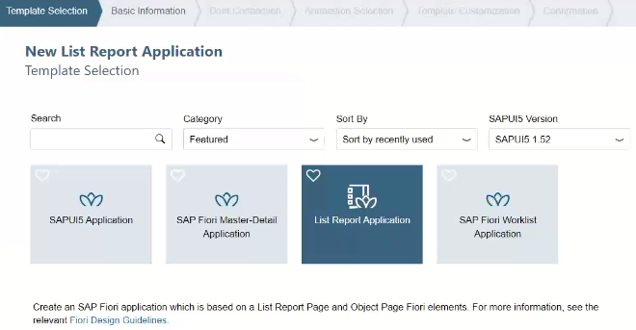
For Creating List Report Application

Slide 6
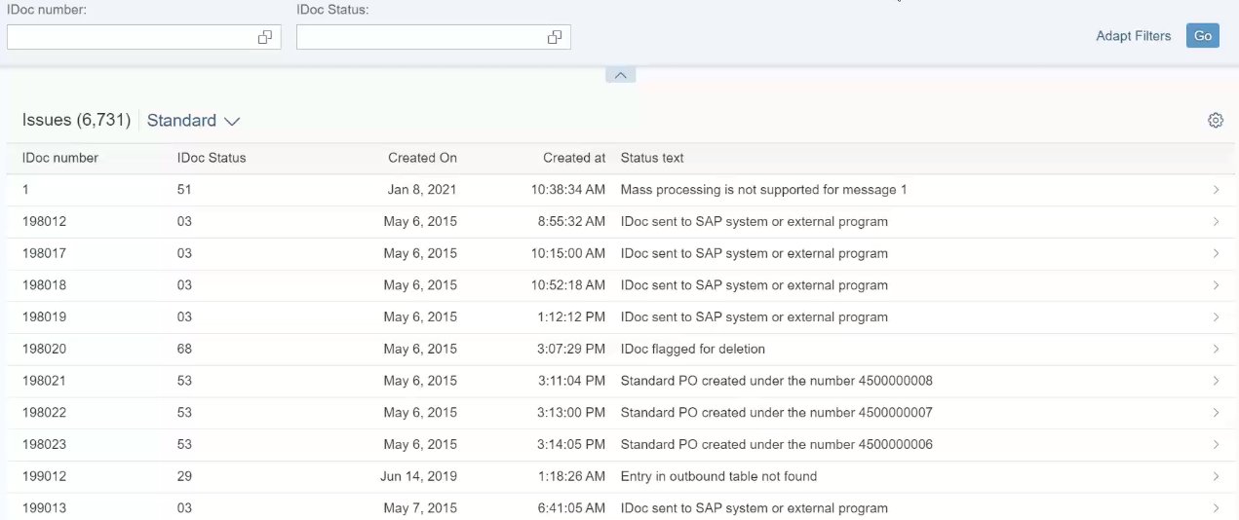
List Report Application
Notes:
The sole purpose of an R/3 system is to provide a suite of tightly integrated, large-scale business applications. R/3 comes prepackaged with the core business applications needed by most large corporations. These applications coexist in one homogenous environment. They are designed from the ground up to run using a single database and one (very large) set of tables.
Presentation: It is usually installed on a user's workstation. When started, the presentation server displays the R/3 menus within a window. This window is commonly known as the SAPGUI, or the user interface (or simply, the interface).
Basis : Basis is like an operating system for R/3. It sits between the ABAP/4 code and the computer's operating system. SAP likes to call it middleware because it sits in the middle, between ABAP/4 and the operating system. ABAP/4 cannot run directly on an operating system. It requires a set of programs (collectively called Basis) to load, interpret, and buffer its input and output. Basis provides the runtime environment for ABAP/4 programs.
Database: The database server is a set of executables that accept database requests from the application server. These requests are passed on to the RDBMS (Relation Database Management System). The RDBMS sends the data back to the database server, which then passes the information back to the application server. The application server in turn passes that information to your ABAP/4 program.

Slide 7
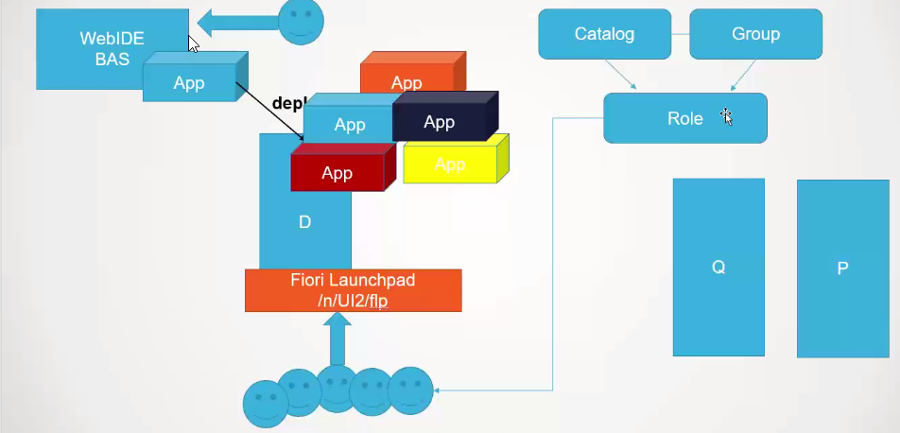
Life cycle of App

Slide 8
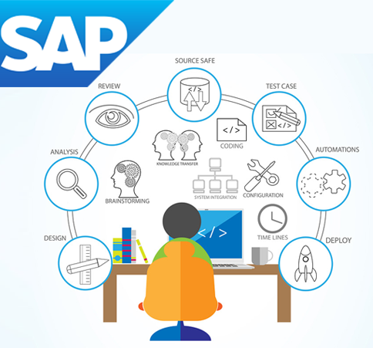

Process of Deployment

Slide 9

Break

Slide 10
End to End ALV IDA ( Integrated Data Access )
Overview. ALV with IDA (SAP List Viewer with Integrated Data Access) helps tables that contain very large quantities of data to be displayed on the UI. ... It uses the in-memory database, such as SAP HANA, without having to switch to a new programming environment.

Slide 11
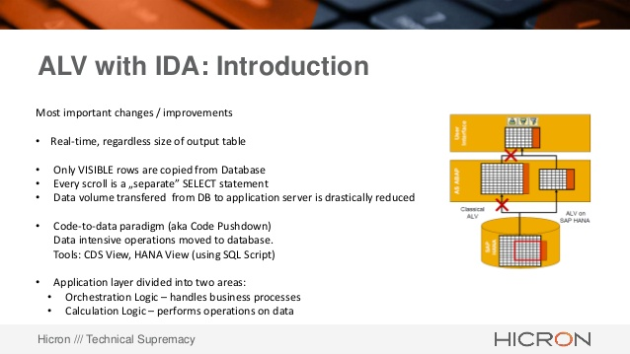

Slide 12
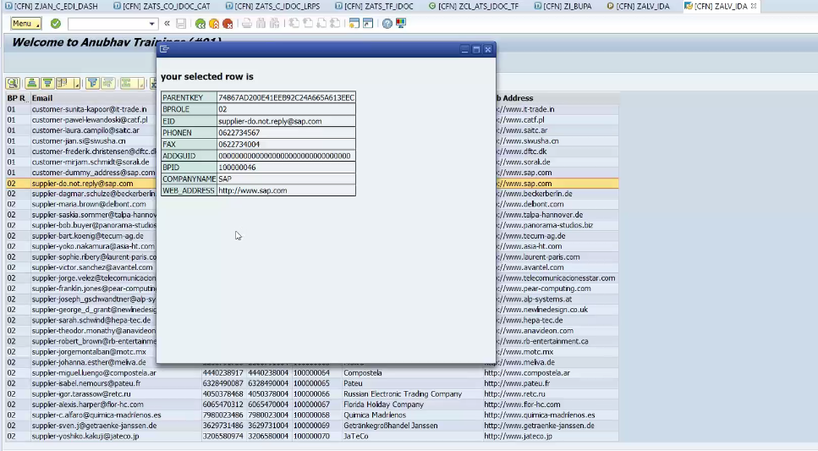
Implementing ALV IDA (Integrated Data Access )

Slide 13
Certification Guidance

Slide 14


Slide 16
Feedback
AnubhavTrainings.com :
https://www.anubhavtrainings.com

Slide 17
End of Day 10

Slide 18

Anubhav Oberoy

